Slide 1
JDBC

Slide 2
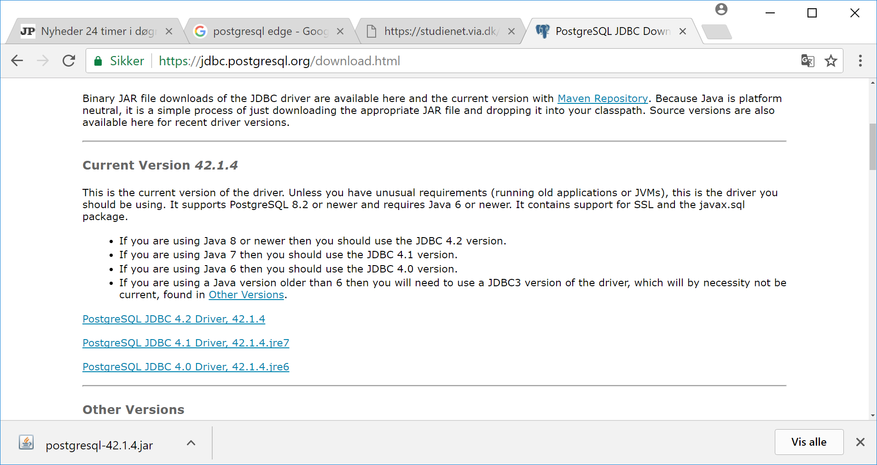
JDBS – Download:

Slide 3
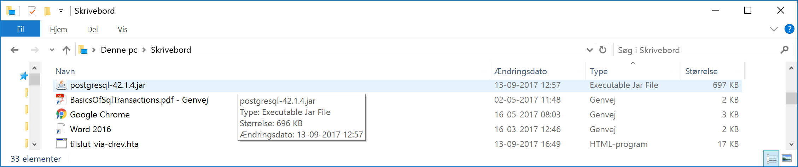
Folder – .jar

Slide 4
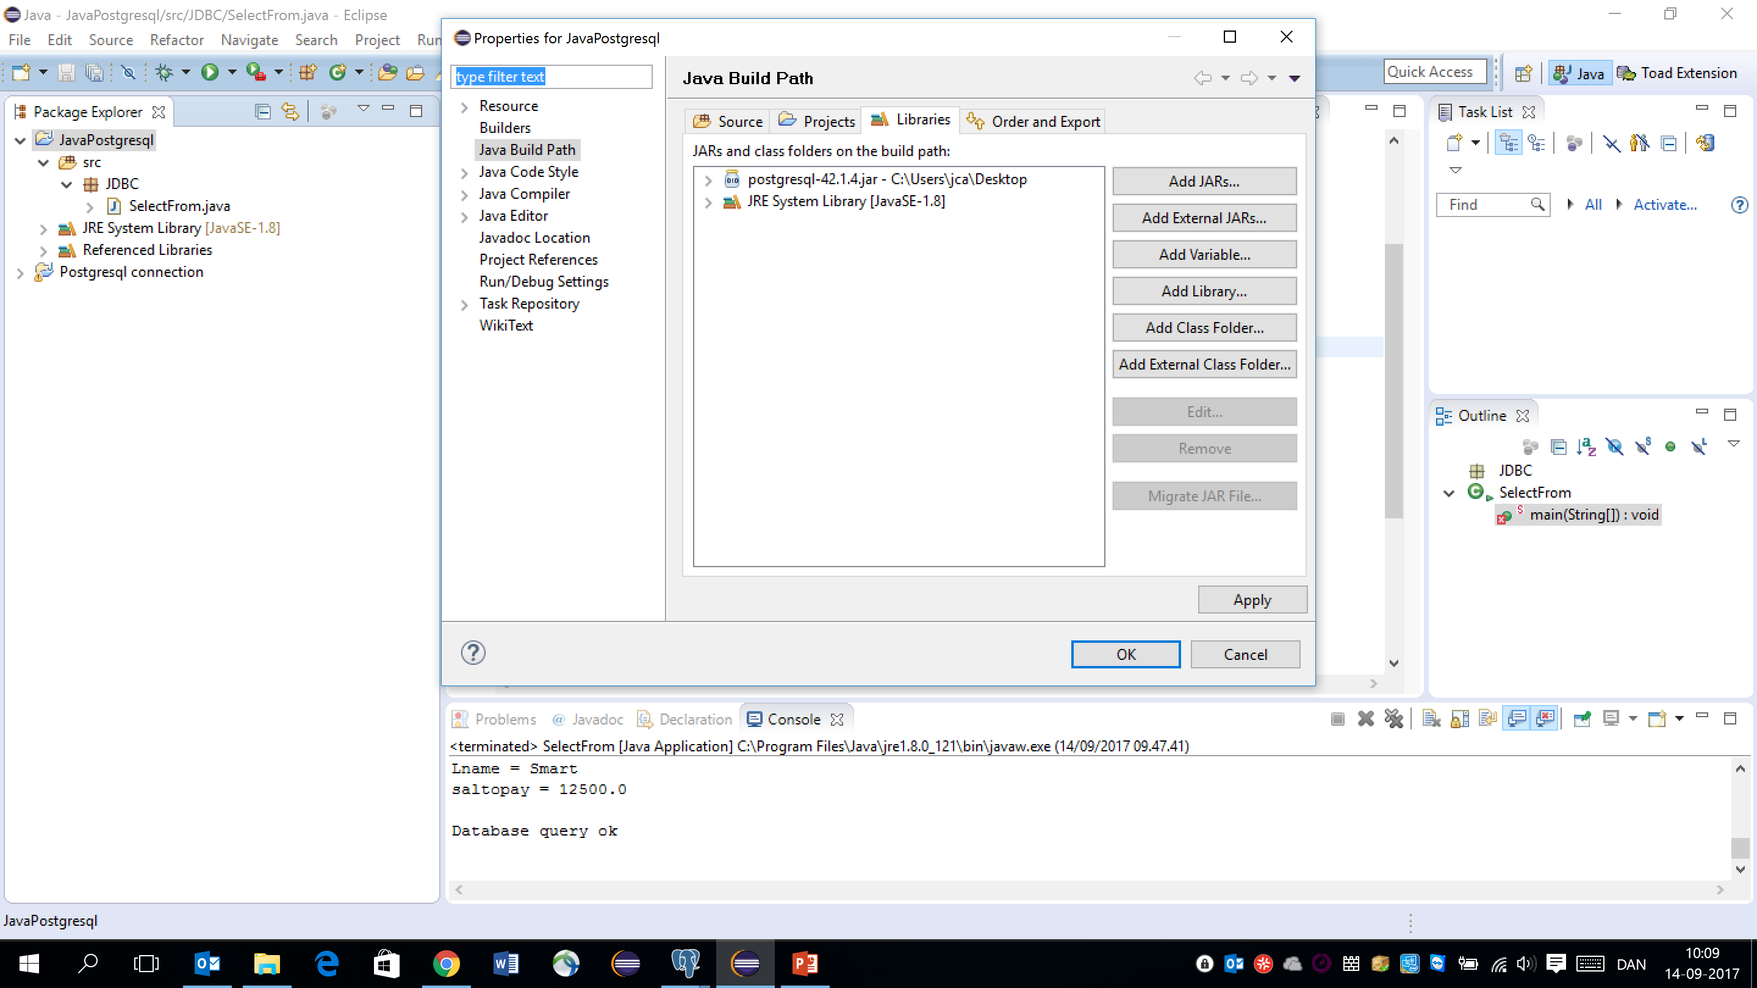

Slide 5
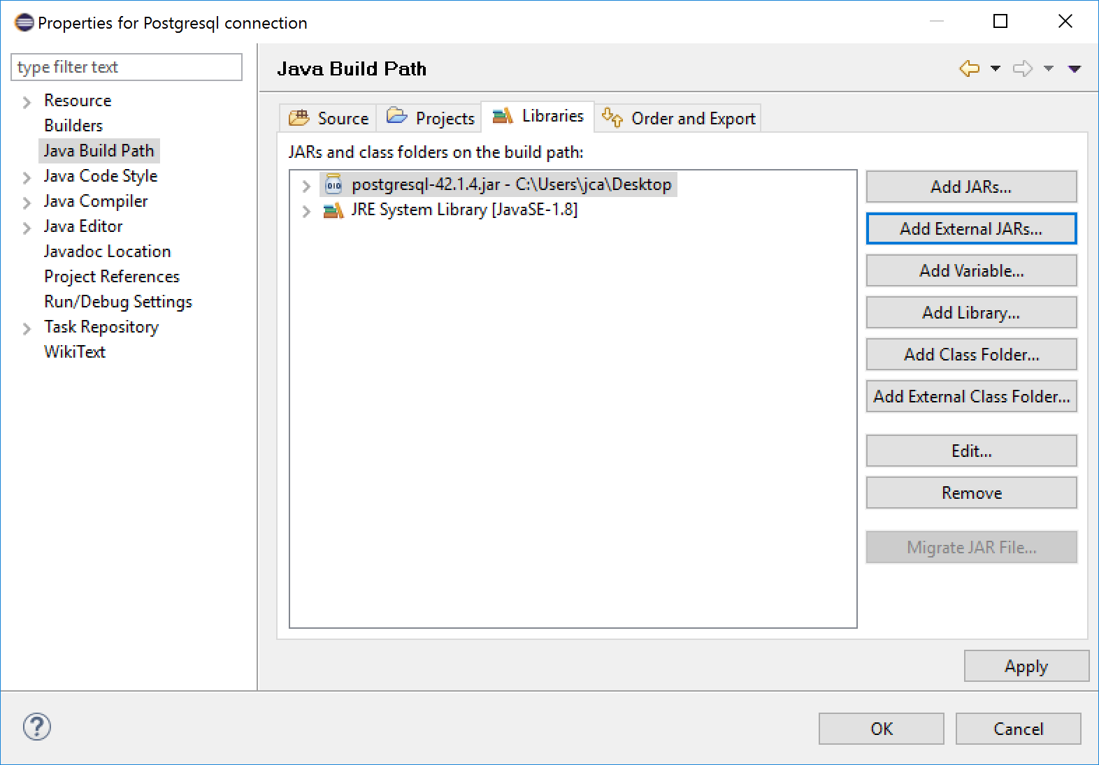
Eclips – Add External Jar File:

Slide 6
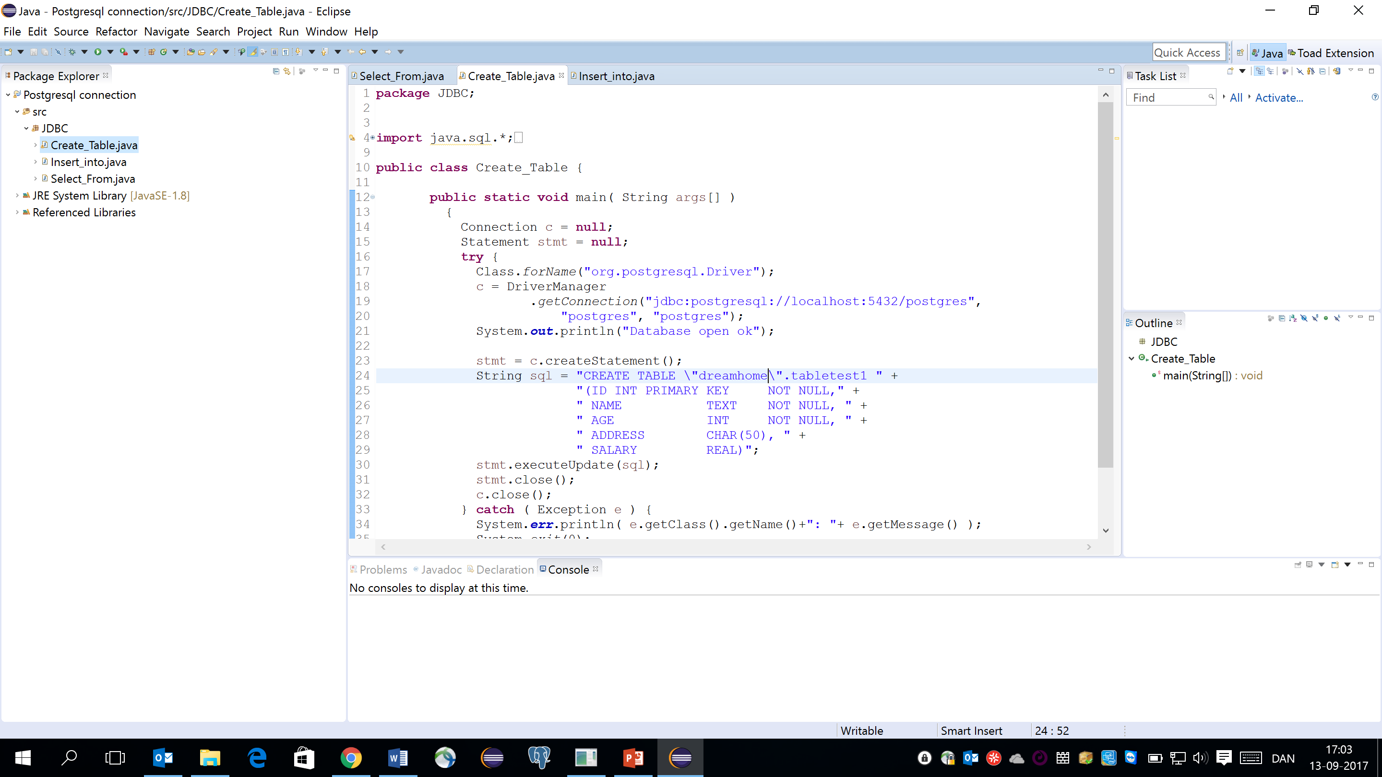
See the examples files in Notes: JDBC.txt

Slide 7
Pitfalls:
Problems with password ... forgotten password:
Example:
ALTER USER Postgres WITH PASSWORD 'Postgres';
Structur:
ALTER USER Postgres WITH PASSWORD '<newpassword>';
JDBC jar fil not installed:
Download from
https://jdbc.postgresql.org/download.html
https://jdbc.postgresql.org/download/postgresql-9.4-1206-jdbc4.jar

